Slide 1
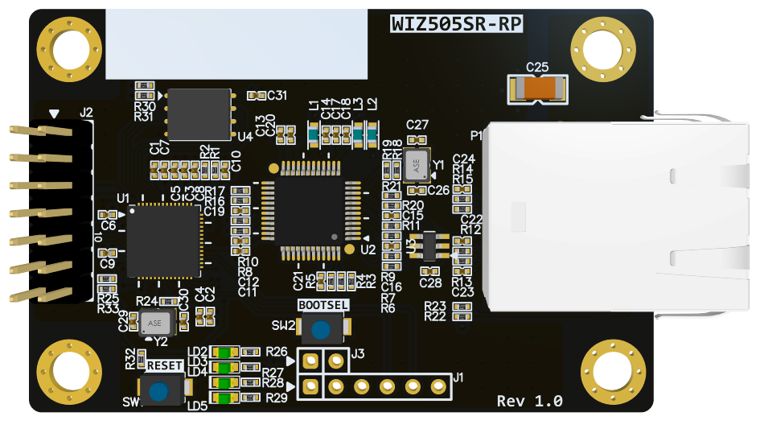
WIZ510SR-RP 3D(TOP)

Slide 2
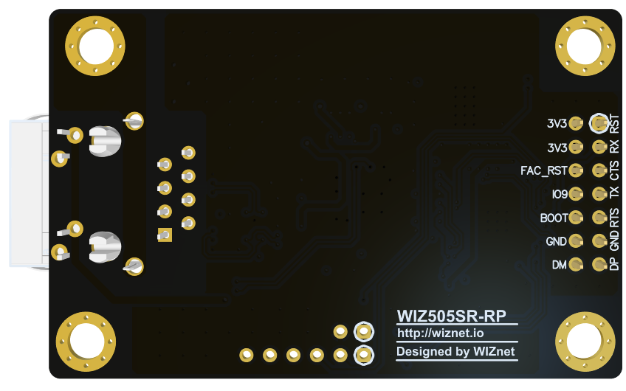
WIZ510SR-RP 3D(BOT)

Slide 3
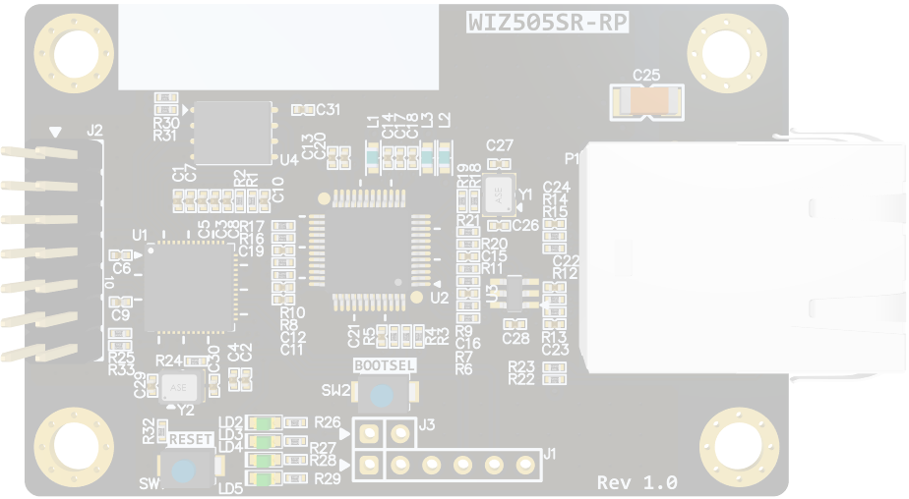

WIZ500SR-RP Callout Top
J2
Header
U4
Flash Memory
U2
W5100S
SW2
BOOTSEL
U1
RP2040
J3
BOOT MODE
(Not Mount)
SW1
RESET
J1
DEBUG (Not Mount)
LD2~5
Indicade LED

Slide 4
WIZ510SR-RP Callout BOT
WIZ510SR-RP 은 bot 실장이 없어서 WIZ510SR-RP 3D(TOP)으로 대체

Slide 5
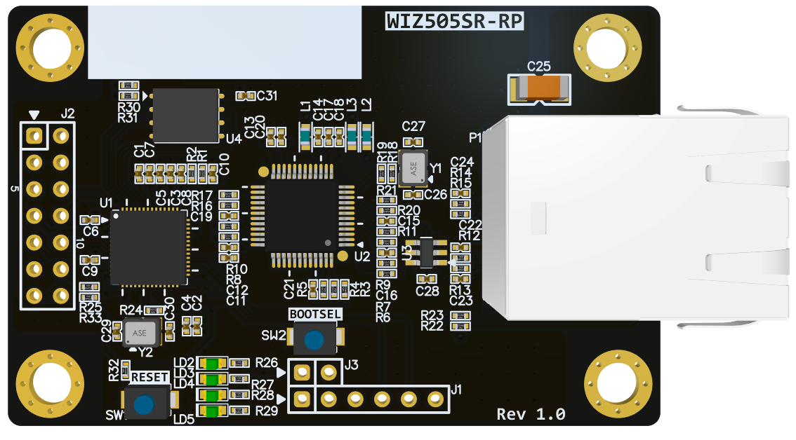
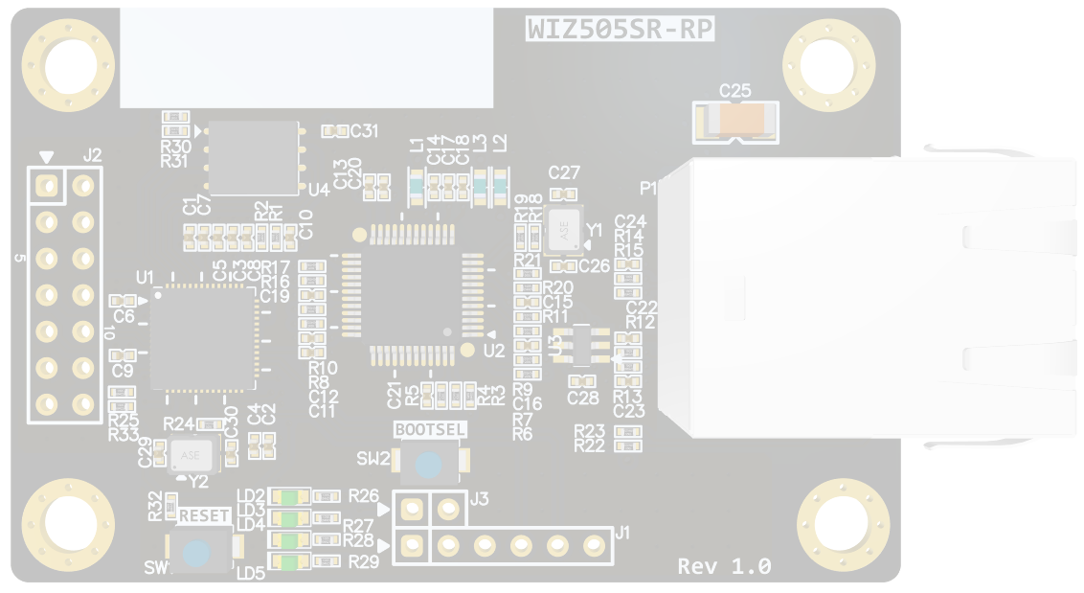
J5
J2
RUN
3V3
UART1_RX
3V3
UART1_CTS
FACT_RST
UART1_TX
HW_TRIG
UART1_RTS
BOOTSEL
GND
GND
J3
USB_DP
USB_DM
J1
BOOTMODE
3V3
GND
UART0 TX
UART0 RX
SWCLK
SWDIO
GND
WIZ505SR-RP Pinout

Slide 6
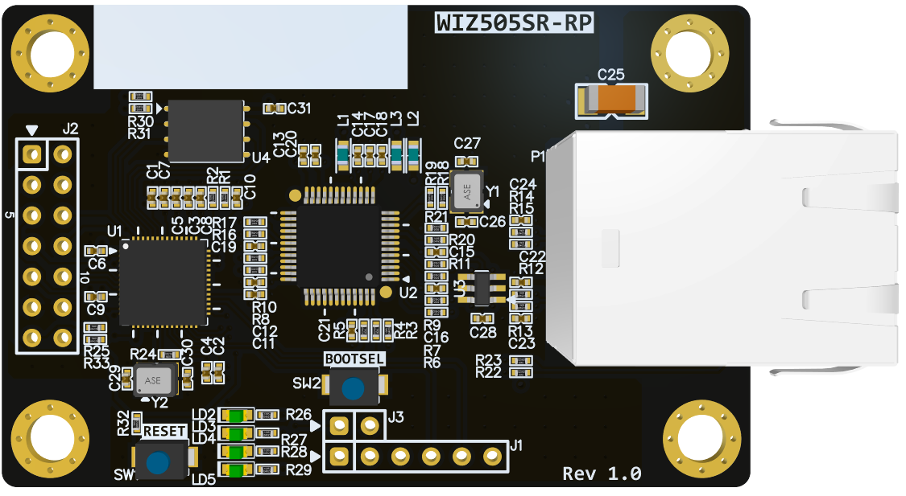
J1
3V3
UART0 TX
UART0 RX
SWCLK
SWDIO
WIZ505SR-RP (J1-Pinmap)
GND
GND

Slide 7
J3
BOOTMODE
GND
WIZ505SR-RP (J3-Pinmap)

Slide 8
J5
J2
RUN
3V3
UART1_RX
3V3
UART1_CTS
FACT_RST
UART1_TX
HW_TRIG
UART1_RTS
BOOTSEL
GND
GND
USB_DP
USB_DM
WIZ505SR-RP (J2-Pinmap)

Slide 9
LD2
LD3
LD4
LD5
GND
WIZ505SR-RP LED

Slide 10
P1
RJ45
WIZ505SR-RP (P1-Pinmap)

Slide 11
SW2
BOOTSEL
WIZ505SR-RP BOOTSEL

Slide 12
SW1
RESET
WIZ505SR-RP RESET

Slide 13
WIZ510SR-RP PCB BOT은
Bottom면에 실장되는 커넥터가 없어 생략

